Slide 1
C++11 Atomics
Wait-Free Synchronization and Queues
© 2018 L. V. Kale at the University of Illinois Urbana
Notes:
Needs more material on C++ atomic

Slide 2
Recall … why the following doesn’t work
Initially: x, Flag, are both 0
Thread 0:
x = 25;
Flag = 1;
Thread 1:
while (Flag == 0);
Print x;
What should get printed?

Slide 3
Sequential Consistency
This is a “desired property” of parallel programming systems
The effect of executing a program consisting of k threads should be the same as some arbitrary interleaving of statements executed by each thread, executed sequentially
Modern processors do not satisfy sequential consistency!

Slide 4
PE₀
PE₁
PE_{p-1}
, . . . ,
Arbitrator
Memory

Slide 5
Support for Memory Consistency Models
OpenMP provides a flush primitive for dealing with this issue
Ensures variables are written out to memory and no reordering of instructions happen across the flush call
With pthreads, in the past, you’d need to use processor-specific memory-fence operations
On Intel
On PowerPC
Load-linked-store-conditional, etc.
C++ recently standardized this
C++-11-atomics in C++-11 Standard
Supports sequential consistency as well as specific relaxed consistency model

Slide 6
C++-11 Atomics
http://en.cppreference.com/w/cpp/atomic/atomic
Basic:
Declare some (scalar) variables as atomic
This ensures accesses to those variables, among themselves, are sequentially consistent
If one thread writes to an atomic object while another thread reads from it, the behavior is well-defined (memory model defines it)
#include <atomic>
Declarations
std::atomic<T> atm_var
std::atomic<T*> atm_ptr
std::atomic <T>* atm_array

Slide 7
Atomic: C++ 11
Atomic | Atomic class template and specializations for bool, int, and pointer type
atomic_store | atomically replaces the value of the atomic object with a non-atomic argument
atomic_load | atomically obtains the value stored in an atomic object
atomic_fetch_add | adds a non-atomic value to an atomic object and obtains the previous value of the atomic
atomic_compare_exchange_strong (obj, expected, desired) | atomically compares the value of the atomic object with non-atomic argument and performs atomic exchange if equal or atomic load if not
Source: https://en.cppreference.com/w/cpp/atomic

Slide 8
atomic_compare_exchange_strong(a,b,c)
a
?
b
c
x
5
=
0
7
5
a
?
b
c
0
=
0
7
7
✔
Notes:
Acquire release to be explained

Slide 9
Memory Order in C++11 Atomics
http://en.cppreference.com/w/cpp/atomic/atomic
Some interesting observations: (example)
http://bartoszmilewski.com/2008/12/01/c-atomics-and-memory-ordering/
atomic<int> data = 0;
data.store(1, memory_order_release);
namespace std {
typedef enum memory_order {
memory_order_relaxed,
memory_order_consume,
memory_order_acquire,
memory_order_release,
memory_order_acq_rel,
memory_order_seq_cst
} memory_order;
}

Slide 10
Locks, Serialization, and Wait-Free Synchronization
Locks are an established way of enforcing mutual exclusion
It also enforces aspects of sequential consistency:
Memory operations are not moved across lock or unlock calls by the compiler
Hardware is made to ensure all writes are completed at lock() or unlock()
But locks are expensive, because they cause serialization

Slide 11
Locks, Critical sections and serialization
Suppose all threads are doing the following
The work in dowork() is t_{w}
The time in critical is t_{c}
The serialization cost becomes a problem as the number of threads increase, but can be small up to #threads < t_{w}/t_{c}
for I = 0, N
dowork();
lock(x);
critical .. ;
unlock(x)

Slide 12
t_{w}
t_{c}
t_{w}
t_{c}
t_{w}
t_{c}
t_{w}
t_{c}
t_{w}
t_{w}
t_{c}
t_{w}
t_{c}
t_{w}
t_{c}
t_{w}
t_{c}
t_{w}
t_{w}
t_{c}
t_{w}
t_{c}
t_{w}
t_{c}
t_{w}
t_{c}
t_{w}
t_{w}
t_{c}
t_{w}
t_{c}
t_{w}
t_{w}
t_{c}
t_{w}
t_{w}
t_{c}
t_{w}
t_{w}
t_{c}
t_{w}
t_{w}
t_{c}
t_{w}
t_{w}
t_{c}
t_{w}
t_{w}
t_{c}
t_{w}

Slide 13
Locks, Serialization, and Wait-Free Synchronization
Locks are an established way of enforcing mutual exclusion
It also enforces aspects of sequential consistency:
Memory operations are not moved across lock or unlock calls by the compiler
Hardware is made to ensure all writes are completed at lock() or unlock()
But locks are expensive, because they cause serialization
Still, for most practical situations, locks are fast enough
Just use locks and avoid all the trouble, in practice
Unless you are in a fine grained situation with many threads
I.e., computation between consecutive calls to lock is very short
Then, consider a wait-free implementation with atomics

Slide 14
An Aside: “Lock-Free Algorithms”
Early days of computer science, there were many research papers and textbook materials on lock-free algorithms
Peterson …
These algorithms all depended on sequential consistency, which processors of the day might have supported
That is no longer true, and so those algorithms are mostly useless
May occasionally provide inspiration for a wait-free algorithm

Slide 15
Example: Circular Fixed-Size Queues
We will look at efficient implementation of shared queues
Depending on sharing assumptions, one can make more efficient queues
General: multiple producers/consumers
Single producer/single consumer
Multiple producers single consumer
Steal queues: (popularized by Cilk)

Slide 16
Circular Queues: Implementation
Array of fixed size 2^n
Masking of indices
0
1
2
3
1021
1022
1023
1
2
3
1021
1022
1023
0
1025
1024
Masking of Indices
1025: 10000000001
Masking
1: 0000000001

Slide 17
Single Producer Single Consumer Queue
We will look at fixed-size queue
Not allowed to grow beyond a fixed limit
Single producer accesses the tail
Single consumer accesses the head
No contention on head and tail
Count number of elements in the queue: used to safeguard against empty and full conditions on the queue
Three implementations
Lockless Thread Unsafe
Locking Thread Safe
Lockless Thread Safe

Slide 18
Single Producer Single Consumer: Lockless – Thread Unsafe
class SPSCQueue{
private:
T* arr;
int count;
int head,tail;
bool deq(T &out){
int ret=0;
if(count>0){
count--;
out=arr[mask(head++)];
ret=1; }
return ret;
}
public:
bool enq(T &data){
int ret=0;
if(count<capacity){
count++;
arr[mask(tail++)]=data;
ret= 1;}
return ret;
}
Using the notion of 'count' to safeguard the queue
But there is contention on the access of count
Both producer and consumer can try to access 'count' at the same time
Can lead to inconsistency
Notes:
Lock version required
Code change and test with results
Animation?

Slide 19
Single Producer Single Consumer: Locking – Thread Safe
class SPSCQueue{
private:
T* arr;
int count
int head,tail;
mutex mtx;
public:
bool enq(T &data){
int ret=0;
mtx.lock();
if(count<capacity){
count++;
arr[mask(tail++)]=data;
ret= 1;}
mtx.unlock();
return ret;
}
bool deq(T &out){
int ret=0;
mtx.lock();
if(count>0){
count--;
out=arr[mask(head++)];
ret=1; }
mtx.unlock();
return ret;
}
Using the notion of 'count' to safeguard the queue
Once the mtx is acquired by a thread no other thread can acquire it before mtx.unlock()
Other threads wait till the lock is released
Locking and unlocking overheads are significant
Note: always release lock before return statement
Notes:
Lock version required
Code change and test with results
Animation?

Slide 20
Single Producer Single Consumer: Wait-Free and Thread Safe
class SPSCQueue{
private:
array<atomic<T>,capacity> arr;
atomic<int> count;
int head,tail;
bool deq(T &out){
if(count.fetch_add(-1)>0){
out=arr[mask(head++)].load()
return 1;}
count.fetch_add(1);
return 0; }
public:
bool enq(T &data){
if(count.fetch_add(1)<capacity){
arr[mask(tail++)].store(data);
return 1;}
count.fetch_add(-1);
return 0; }
Make count atomic (accessed by producer and consumer) to prevent contention
2 atomic operations per enq or deq operation in the normal case
Notes:
Code change and test with results
Animation?

Slide 21
Head
Head
Atomic
Atomic
Atomic
Atomic
Atomic
Atomic
Tail
Tail
Tail
Tail
Notes:
Required

Slide 22
Multiple Producer Single Consumer Queue
Assume fixed size, power of 2
Multiple producers access the tail; contention on tail
Single consumer accesses the head; no contention on head
We will use the notion of an 'EMPTY' element
A specific value denotes empty in the queue (say –1)
Producer thread checks if a position contains EMPTY before inserting to it
Consumer thread checks if a position does not contain EMPTY before extracting a value from it
After extracting the value it inserts EMPTY in that position
Three implementations
Lockless Thread Unsafe
Locking Thread Safe
Lockless Thread Safe

Slide 23
Multiple Producers Single Consumer: Thread Unsafe
class MPSC_Queue{
private:
T* arr;
int head,tail;
bool deq(T &out){
if(arr[mask(head)]!=EMPTY)return 0;
else{
out=arr[head];
arr[mask(head++)]=EMPTY;
return 1;
}
}
public:
bool enq(T &data){
if(arr[mask(tail)]==EMPTY)return 0;
else{
arr[mask(tail++)]=data;
return 1;
}
}
There may be contention on tail as result of multiple producers
There may be contention on each cell in arr as multiple producer threads or a producer and consumer thread may try to access it at the same time

Slide 24
C1
Head
Head
C1Head
Corrupt
Garbage
P1Tail
Tail
P2Tail
Tail
P1
P2

Slide 25
Multiple Producers Single Consumer: Thread Unsafe (1.0)
class MPSC_Queue{
private:
T* arr;
int head
int tail;
bool deq(T &out){
if(arr[mask(head)]==EMPTY)return 0;
else{
out=arr[head];
arr[mask(head++)]=EMPTY;
return 1;}
}
public:
bool enq(T &data){
if(arr[mask(tail)]==EMPTY){
arr[mask(tail++)]=data;
return 1;}
else return 0;
}
We will modify the lockless thread unsafe version into a lockless thread safe version in 2 steps

Slide 26
Multiple producers Single Consumer: Locking-Thread Safe
class MPSC_Locking_Queue{
private:
T* arr;
int head,tail;
mutex mtx;
public:
bool enq(T &data){
int ret;
mtx.lock();
if(arr[mask(tail)]==EMPTY){
arr[mask(tail++)]=data;
ret=1;}
else ret=0;
mtx.unlock();
return ret;
}
bool deq(T &out){
printf("Dequing\n");
int ret;
mtx.lock();
if(arr[mask(head)]==EMPTY)ret=0;
else{
out=arr[mask(head++)];
ret=1;}
mtx.unlock();
return ret;
}
Once the mtx is acquired by a thread no other thread can acquire it before mtx.unlock()
Other threads wait on the critical section till the lock is released
Locking and unlocking overheads are significant
Note: always release lock before return statement (ret helps with that)

Slide 27


C1
C1Head
Head
Head
P1Tail
P2Tail
Tail
Tail
Tail
P1
P2
Notes:
T-> tail
Better looking animations

Slide 28
Multiple Producers Single Consumer: Thread Unsafe (1.0)
class MPSC_Queue{
private:
T* arr;
int head
int tail;
public:
bool enq(T &data){
if(arr[mask(tail)]==EMPTY){
arr[mask(tail++)]=data;
return 1;
}
else return 0;
}
bool deq(T &out){
if(arr[mask(head)]!=EMPTY)return 0;
else{
out=arr[head];
arr[mask(head++)]=EMPTY;
return 1;
}
}
We will modify the lockless thread unsafe version into a lockless thread safe version in 2 steps

Slide 29
Multiple producers Single Consumer: Thread Unsafe (1.1)
class MPSC_Queue{
private:
T* arr;
int head;
atomic<int> tail;
public:
bool enq(T &data){
int mytail=tail.fetch_add(1);
if(arr[mask(mytail)]==EMPTY){
arr[mask(mytail)].store(data);
return 1;}
else{
tail.fetch_add(-1);
return 0;}
}
bool deq(T &out){
out=arr[mask(head)];
if(out==EMPTY)return 0;
else{
arr[mask(head++)]=EMPTY;
return 1;
}
}
The previous version was vulnerable to conflicts between 2 producers
The reason being that the access to the tail was not exclusive
Change the tail into an atomic variable
Modify the operations accordingly (atomic::fetch_add) replaces post increment operation

Slide 30
Multiple Producers Single Consumer: LockLess – Thread Safe
class MPSC_Lockless_Queue{
private:
array<atomic<T>,capacity> arr;
int head;
atomic<int> tail;
public:
bool enq(T &data){
int mytail=tail.fetch_add(1);
if(arr[mask(mytail)].load()==EMPTY){
arr[mask(mytail)].store(data);
return 1;}
else{
tail.fetch_add(-1);
return 0;}
}
bool deq(T &out){
out=arr[mask(head)].load();
if(out==EMPTY)return 0;
else{arr[mask(head++)].store(EMPTY);
return 1;}
}
The previous version did not prevent a conflict between a producer and a consumer
Make the underlying data structure of the queue an array of atomics
Modify the operations accordingly
Note: load() and store() calls are not compulsory on atomics. A simple assignment operation can do the same operation
Notes:
test

Slide 31
Multiple Producers Single Consumer: LockLess – Thread Safe
class MPSC_Lockless_Queue{
private:
array<atomic<T>,capacity> arr;
int head;
atomic<int> tail;
public:
bool enq(T &data){
int mytail=tail.fetch_add(1);
if(arr[mask(mytail)].load()==EMPTY){
arr[mask(mytail)].store(data);
return 1;}
else{
tail.fetch_add(-1);
return 0;}
}
bool deq(T &out){
out=arr[mask(head)].load();
if(out!=EMPTY)
{arr[mask(head++)].store(EMPTY);
return 1;}
return 0;
}
Analysis:
3 Atomic Operations per enq in the normal case
3 Atomic Operations per enq in the extreme case
2 Atomic Operations per deq in the normal case
1 Atomic Operations per deq in the extreme case
Notes:
test

Slide 32
P1 atomically fetches and increments the value of global tail
C1 attempts consumption and finds empty value (failure)
P2 atomically fetches and increments the value of global tail
P2 adds 15 to the queue
P1 adds 7 to the queue
C1 (non-atomically) fetches and increments the value of global head
C1 attempts consumption again and finds 7 (success)
C1 attempts consumption again and finds 15 (success)
C1
C1Head
C1Head
Head
Head
Head
Fail
7
15
Tail
Tail
Tail
P1Tail
P2Tail
P1
P2

Slide 33
C1
C1Head
Head
Head
Atomic
Atomic
Atomic
Tail
Tail
Tail
P1Tail
P2Tail
P1
P2
Notes:
Steps to be more clear

Slide 34
Memory Model
Memory model is useful to modify the behavior of atomic load/store operations
x.load(std::memory_order_abc)
Memory Model | Explanation
memory_order_relaxed | No synchronization or ordering constraints imposed on other reads or writes Only this operation's atomicity is guaranteed x.load(std::memory_order_relaxed)
memory_order_acquire | Only for load operations No reads or writes in the current thread can be reordered before this load All writes in other threads that release the same atomic variable are visible in the current thread
memory_order_release | Only for store operations No reads or writes in the current thread can be reordered after this store Writes in the current thread are visible in other threads that acquire the same atomic variable Writes that carry a dependency into the atomic variable become visible in other threads that consume the same atomic
Source: https://en.cppreference.com/w/cpp/atomic/memory_order

Slide 35
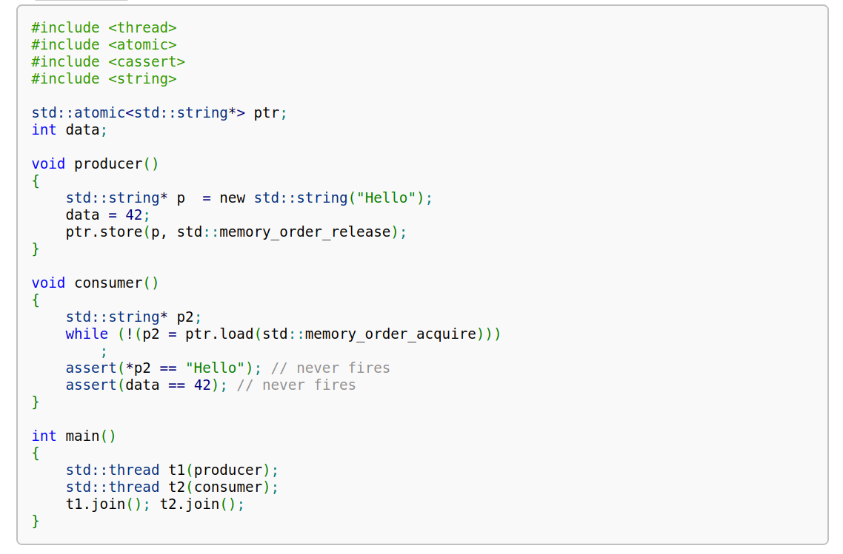
Release Acquire Ordering
Source: https://en.cppreference.com/w/cpp/atomic/memory_order

